Slide 1
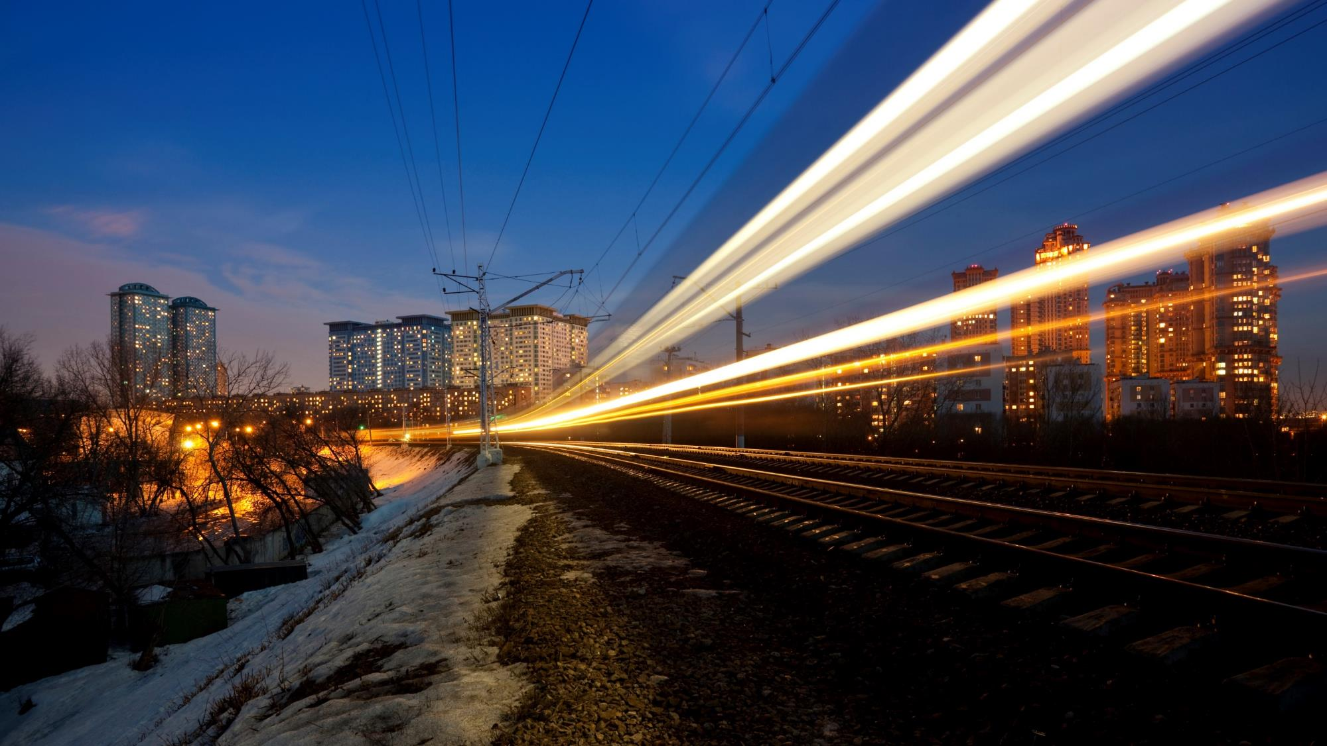
Trechnology GmbH
Innovating trams, trains and transport
18.11.2024
241118_Company_Presentation_GAB-PT-ES_TRE.pptx

Slide 2
Who we are
trechnology
Manufacturers
Operators
Maintainers
Tendering entities
Consulting company for rail transportation and rolling stock technology
Mediator between industry, operators, integrators and suppliers, as well as all players in the entire vehicle life cycle
Efficient procurement, commissioning, Operation and maintenance of needs-based vehicle concepts
Innovative fleets in rail passenger transportation
Technical editing and documentation management (DE/EN/ES)

Slide 3
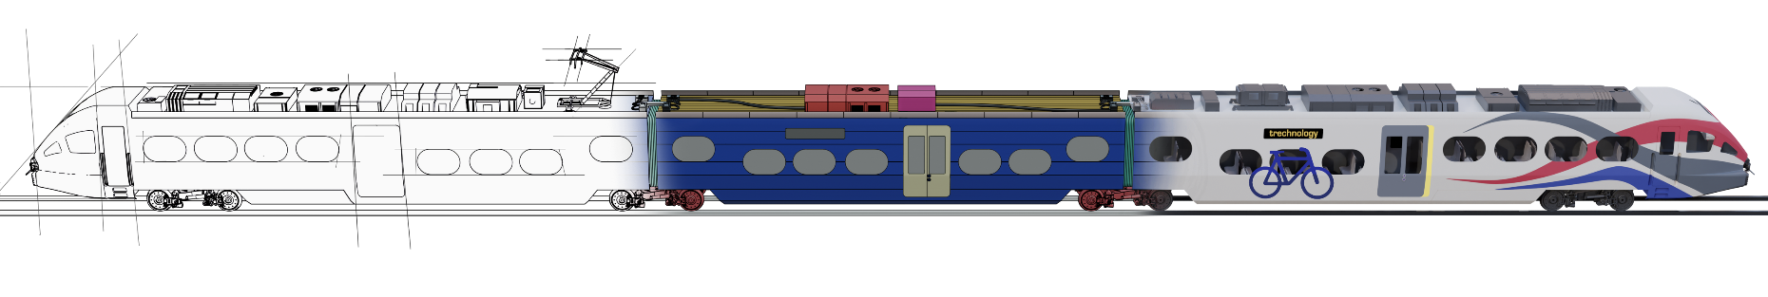
What we do
Feasibility
Concept
Tender
Construction
Production
Homologation
Acceptance
Warranty
Maintenance
-Vehicle layout
-Profile design
-Traction sizing
-…
-Requirements compliance
-Quality management
-Construction support
-…
-Consulting
-Support
-…
-Consulting
-Management
-Support
-…
-Market studies
-Timetable compliance
-Energy consumption
-…
-Requirements preparation
-Requirements analysis
-Support
-…
-Quality management
-Support
-…
-Consulting
-Quality control
-Support
-…
-Consulting
-Support
-…

Slide 4









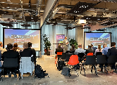




References
Rhine-Ruhr Public Transport Association (VRR)
Manufacture, delivery and maintenance of over 60 battery vehicles
Schleswig-Holstein Public Transport Association (NAH.SH):
Manufacture and delivery of 55 battery vehicles
Rhineland-Palatinate South Public Transport Association (ZÖPNV Süd):
Manufacture and delivery of 44 battery vehicles for the „Pfalz“ network
Berlin-Brandenburg Public Transport Association (VBB):
Manufacture and delivery of 31 battery vehicles for the „NOB2“ network
Mecklenburg-Vorpommern Transport Company (VMV):
Manufacture and delivery of 15 battery vehicles for the „Warnow II“ network
Leipzig Public Transport Association (ZVNL):
Manufacture and delivery of 75 vehicles (thereof 16 battery vehicles)
Bonn Public Transport Company (SWB):
Manufacture and delivery of 22 (up to 32) high-floor light rail vehicles type BN85D
Hannover Transport Company (ÜSTRA):
Manufacture and delivery of 42 (+233 optional) high-floor light rail vehicles type TW4000
Essen Transport Company (Ruhrbahn):
Manufacture and delivery of 46 (+5 optional) high-floor light rail vehicles
type HF1
DB Regio:
Market study of current vehicle concepts with alternative drive systems (HEMUs, BEMUs)
Saxony-Anhalt Local Transport Service (NASA):
Feasibility study on alternative drive systems in regional public transport in Saxony-Anhalt
Eurailpress Forum „Alternative drives in regional rail transport“:
Permanent guest since 2019
Lecture 2023: „Vehicle technology formation: Current BEMU concepts and what the market can derive from them “
Bahn Manager Magazin
Guest article: „Efficient procurement of alternative drive systems – a national challenge“
Issue 2 - 2024

Slide 5
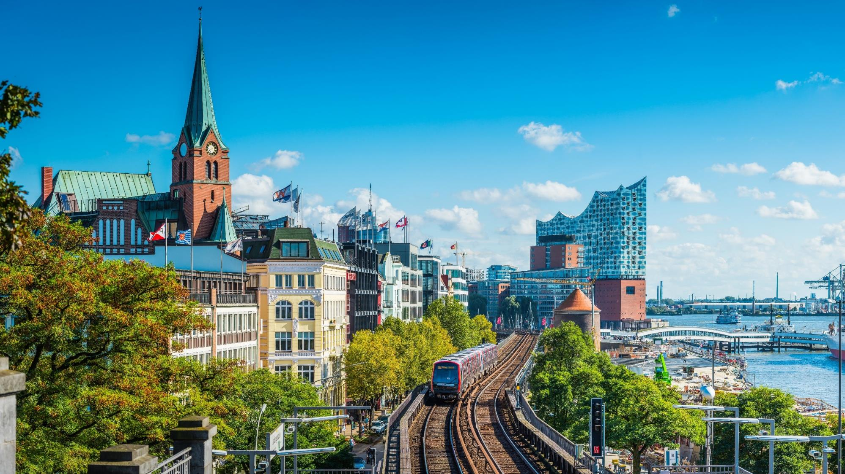
Thank you!
We look forward to our cooperation
trechnology GmbH I innovating trams, trains & transport | Bei den Wettern 11, 21614 Buxtehude | info@trechnology.net |+49 4161 9946093

