Slide 1
Mafex – Current view of the Spanish railway industry
III Jornada Hispano –Alemana sobre el Secor Ferroviario
21 Nov 2024

Slide 2



MAFEX - Spanish Rail Industry
Main Trends of the sector
Markets
Technology
Regulation
Main challenges of the railway sector globally
Financing and Public Private Partnerships
Visibility of the sector
Digitalization
Intermodality
Sustainability
Talent

Slide 3


MAFEX - Spanish Rail Industry
Who we are
83% of the Spanish railway exports
118
+20
Turnover (2022)
7.5% of industrial GDP in Spain
members
billion €
Jobs in Spain
+30.000
4%
Of railway turnover invested in R&D
Countries in which are present
+100
+300
Delegations around the world

Slide 4
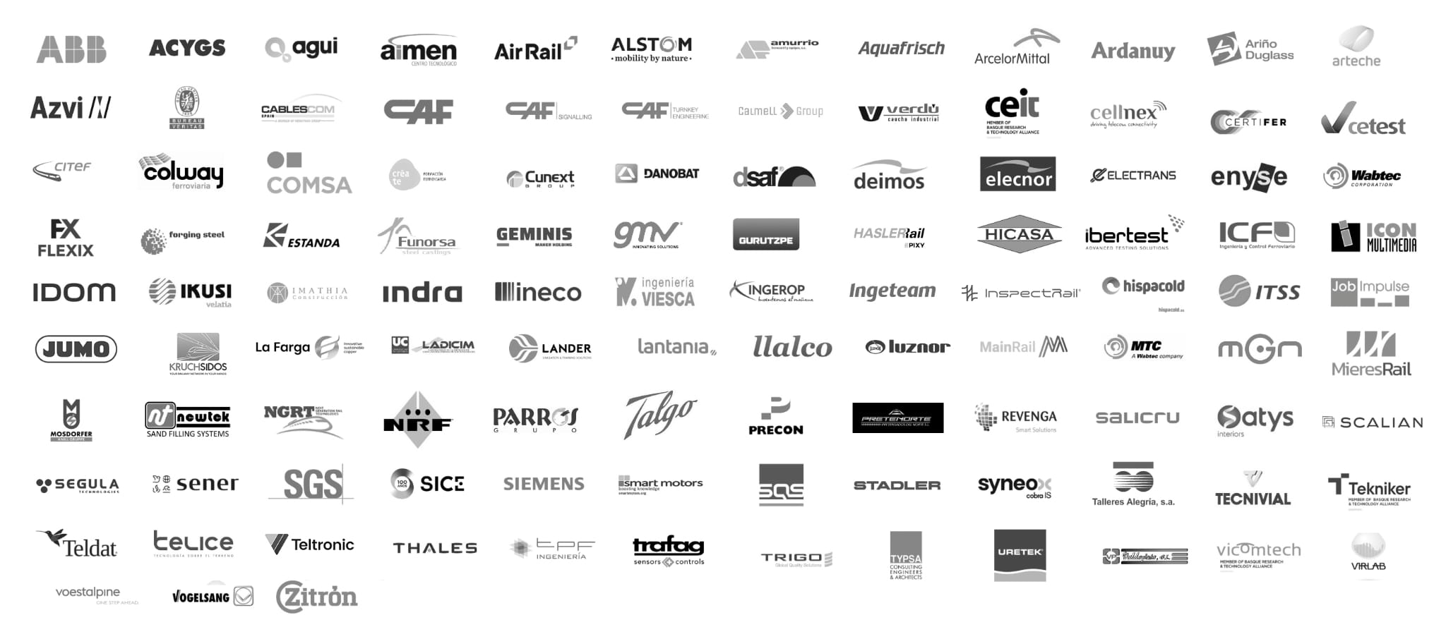


















MAFEX - Spanish Rail Industry
118 member companies
Members of
Collaboration Entities
Spanish Confederation of Business Organizations
Spanish Railways Technological Platform
AGEX Group
European Rail Cluster Initiative
European Rail Supply Industry Association

Slide 5








MAFEX - Spanish Rail Industry
A unique sectorial value chain
TRAFFIC AND SIGNALLING CONTROL SYSTEMS, COMMUNICATION, PASSENGER INFORMATION AND TICKETING
MAINTENANCE: EQUIPMENT, SERVICES AND RENOVATIONS
INFRASTRUCTURE/
SUPERSTRUCTURE
ENGINEERING, CONSULTANCY & CERTIFICATION
VEHICLE SYSTEMS, EQUIPMENT AND COMPONENTS
ROLLING STOCK

Slide 6




MAFEX - Spanish Rail Industry
The strength of a pioneering industry
High-speed
Urban transport
ERTMS
Automated lines
Second largest high-speed network in the world - 4.000 km
9 cities with metropolitan rail networks and 12 cities with trams
At the forefront of ERTMS signalling with more than 2.700 km
Most extensive automatic metro line in Europe (Barcelona’s L9)

Slide 7














MAFEX - Spanish Rail Industry
High-speed: main Spanish projects in the world
High-speed
Baltic rail
Follo Line
Oslo Airport
Express Line
HS2
Rome-Naples
High-Speed Line
Tashkent-Samarkand
Line
Baltic Countries
Norway
Norway
Great Britain
Italy
Uzbekistan
Ankara-Istanbul
high-speed leg
Halkali-Kapikule
high-speed project
Mecca-Medina
High-Speed Line
New Delhi-Kolkata
High-Speed Line
High-speed
in California
Houston-Dallas
Connection
Turkey
Turkey
Saudi Arabia
India
United States
United States

Slide 8
MAFEX - Spanish Rail Industry
Urban transport: did you know?
Urban transport
35% of South America’s metro networks and more than 25% of European ones have Spanish technology
Spanish solutions such as tram-trains are increasingly demanded by cities around the world
The Spanish industry ranks at the top as advisor and developer of metro and tramway systems
Spanish companies have implemented the most advanced smart operational control centers
Spanish companies have created pioneering systems and technologies to manage stations of the future
A unique value proposal with comprehensive urban transport solutions on the five continents

Slide 9


MAFEX - Spanish Rail Industry
Some of the Spanish solutions to the new challenges
Eco railway proposals
Talent attraction
Passsenger experience
Digitalization
Intermodality
Use of renewbale energies in facilities and in commercial operation
New manufacturing methods for environmentally friendly cement
Eco-efficient traffic monitoring and driving management systems
Energy recovery braking systems
Fast charging at tram stations with battery systems on board
Catenary-free trams
Hydrogen train
Infrastructure digitalization through BIM
Smart railway stations
Flexible automatic driving systems
Automatic protection and operation systems
Energy Management Systems (EMS) to reduce on-board energy consumption
Fleet systems to optimize energy consumption management and control
AI for predictive maintenance
IoT hardware platforms to integrate all on-board equipment
Railway connections to ports 4.0
Systems for the traceability of goods
Solutions for a connected intermodal transport
Wide variety of specialized railway training
Official Master degrees in railway engineering, BIM and numerous other disciplines
Career development plans
Centralized operating and planning systems
Preventive access control system
Real-time information on infrastructure and train occupancy
Intelligent passenger density solutions
Contactless electronic ticketing and payment methods

Slide 10

MAFEX - Spanish Rail Industry
What we do
ONE - STOP SHOP
Supporting internationalization
Promotion and value enhancement of the sector
Facilitating the exchange of knowledge
Enhancing the collaboration between institutions and companies
Internationalization and innovation as key elements for the competitive improvement of the industry

Slide 11









MAFEX - Spanish Rail Industry
Activities and services
International Promotion
Working Groups
Innovation & Skills
Strategic Intelligence
Forums
Institutional Relations
Trade Policy
R&D Project Office
Marketing & Communication

